Slide 1
Vast Challenge 2018 MC2 - 2nd Progress Presentation
By: Mitchell, Anthony, Janvi, and Rocco

Slide 2
Contributions
Anthony - Contributed 3 Tableau graphs, slides 12-14, proofread/organized slides, and presented to the class
Janvi - Contributed 1 Tableau graph, slides 3, 7, proofread slides
Mitchell - Contributed 4 Tableau graphs, slides 10-11, proofread/organized slides, and presented to the class
Rocco - Contributed 3 Tableau graphs, Communicated with the team, and slides 4, 5, 6, 8, 9

Slide 3
Quick Summary of 1st Progress
Purpose of project- analyze the water sensor data from the wildlife preserve to help determine if a local furniture factory is dumping toxic chemicals
There has been a definite increase in total amounts of chemicals in the waterways from 1998-2016 (18 year period).
Specific years of interest include: 2003, 2008-2009, and 2014-2016
Potential trends could be found in the chemicals of iron, aluminum, and methylosmoline.

Slide 4
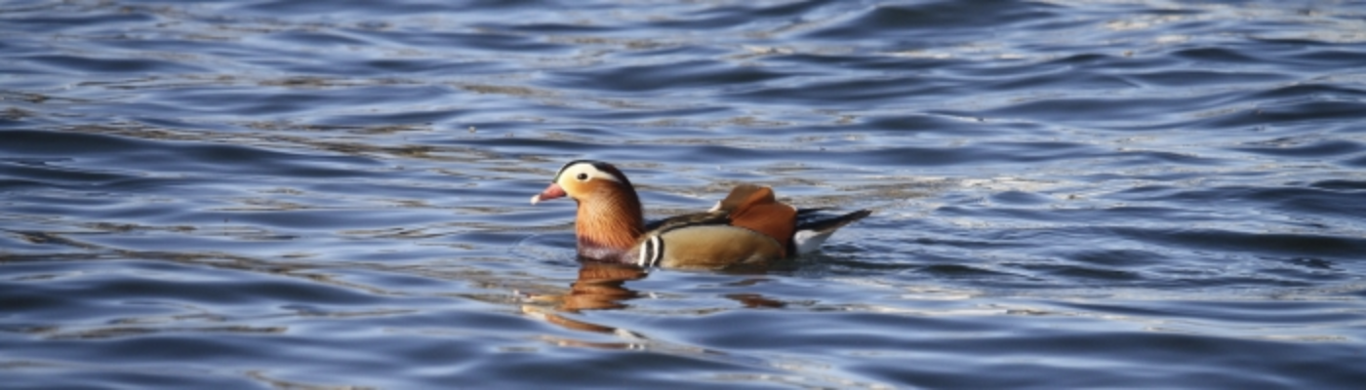
Question
What anomalies do you find in the waterway samples dataset? How do these affect your analysis of potential problems to the environment? Is the Hydrology Department collecting sufficient data to understand the comprehensive situation across the Preserve? What changes would you propose to make in the sampling approach to best understand the situation? After reviewing the data, do any of your findings cause particular concern for the Pipit or other wildlife?

Slide 5
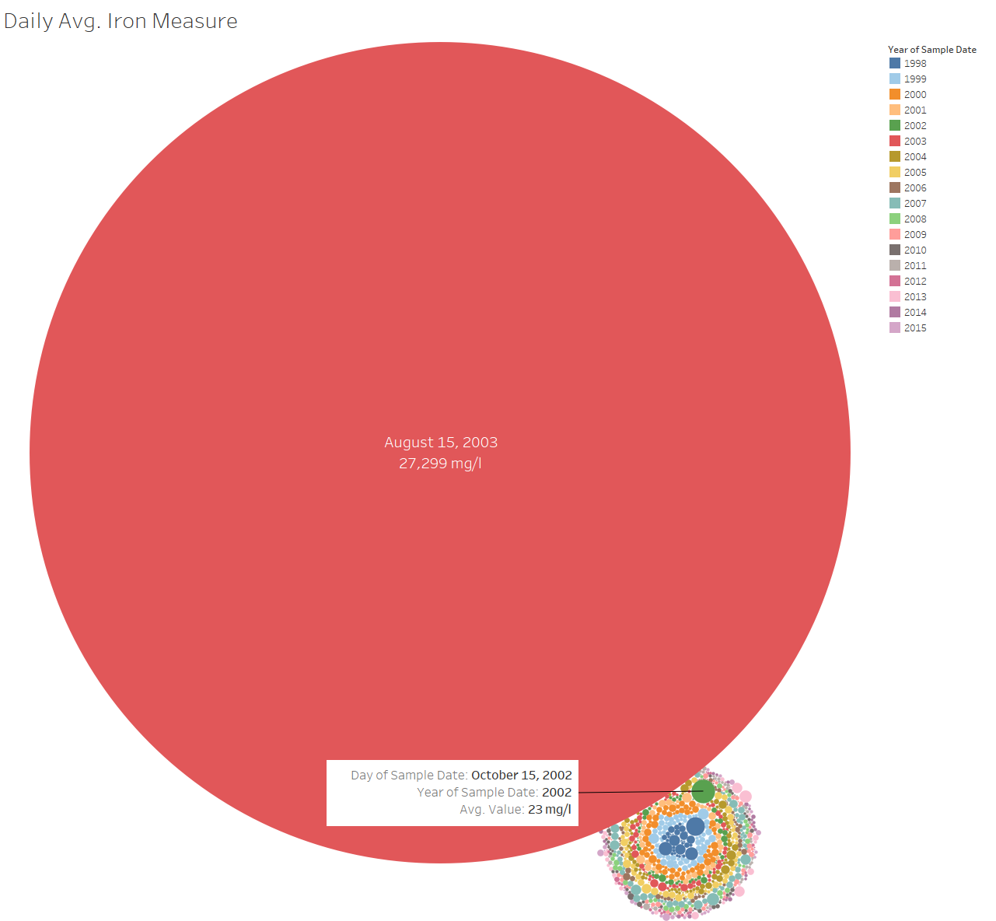
Toxicity of Chemicals
Iron - Iron is only hazardous in large quantities over an extended period of time. There was only one spike of iron on one day in 2003. We can ignore this spike.
Notes:
The largest measure is a little more than 1000 times more than the 2nd largest.

Slide 6
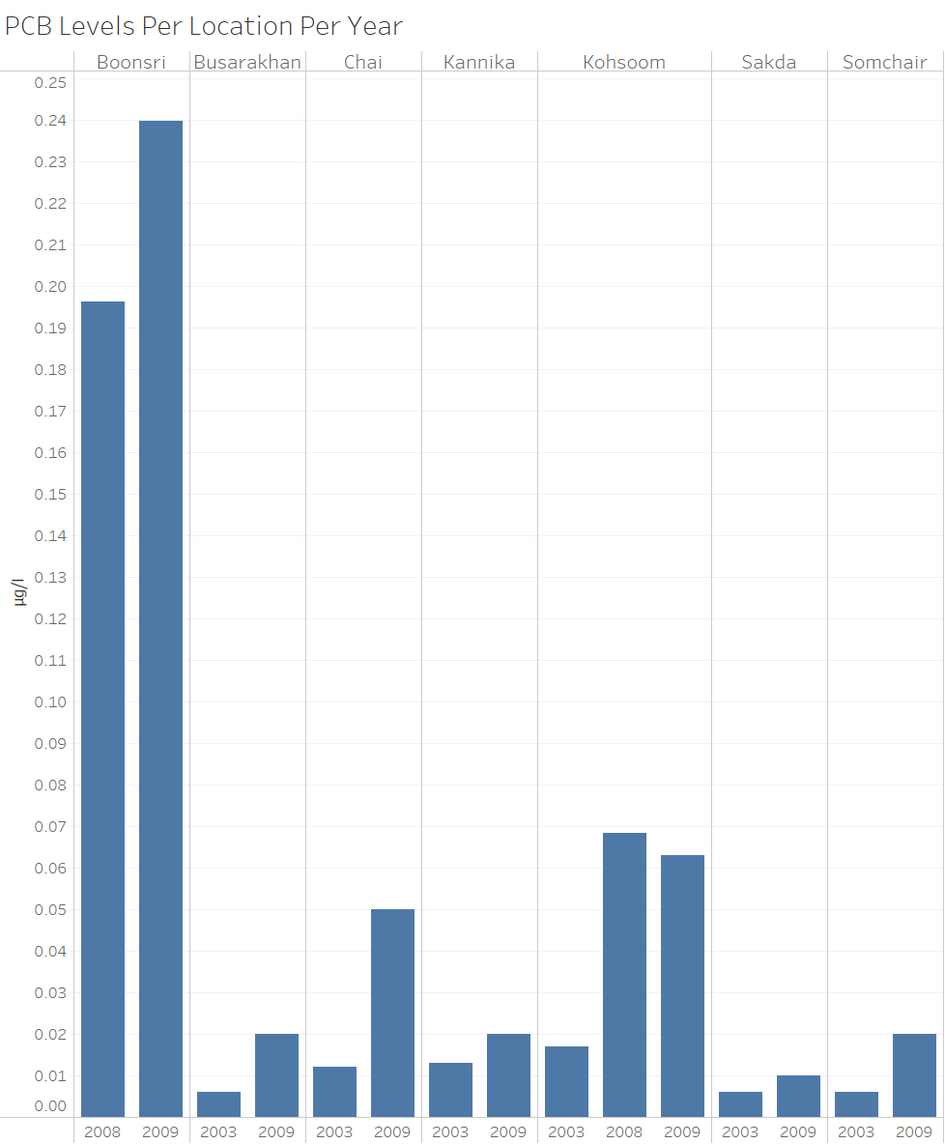
Toxicity of Chemicals
Polychlorinated biphenyl (PCB) - Is a highly toxic chemical found in the highest amounts at Boonsri and Kohsoom.
PCB is often found within motors, oil, oil-based paint, furniture polish/finish, and conveyor belts – all of which are commonplace in a furniture factory.
PCB was outlawed in the USA in 1978. High levels of exposure can cause chronic breathing issues with the nose, throat or severe rashes/acne, or cancer. Low levels of exposure can disrupt the hormone balance of animals.
Notes:
PCB ties into next slide about Pentachlorobenzene

Slide 7
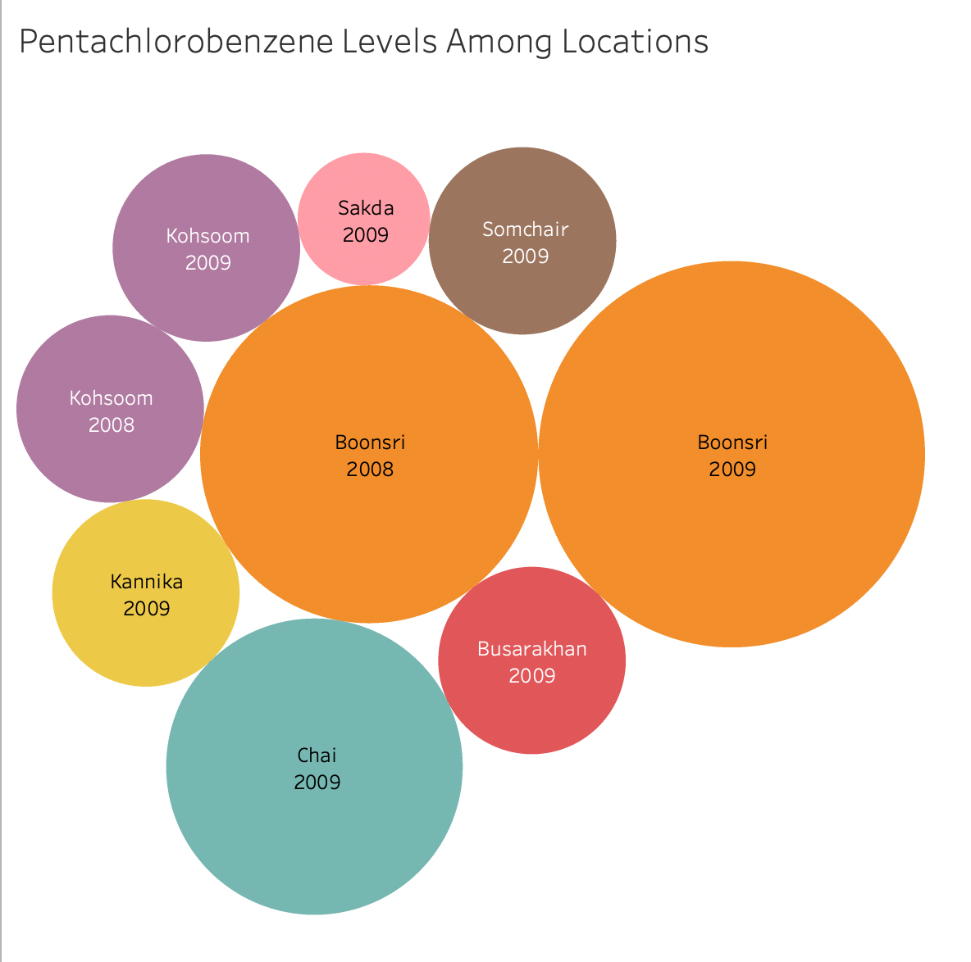
Toxicity of Chemicals
Pentachlorobenzene - Is another toxic chemical that was found mostly in Boonsri and Chai.
It can be used as a Fungicide, fire retardant, dye carrier, and can be mixed with PCB to reduce the viscosity.
It is very toxic to aquatic life and has long lasting effects. It was banned globally in 2009.
Notes:
Since this and PCB shows up at the same time we can assume they are linked.
Since this was banned in 2009 and hasn’t been measured since, we can assume that this is no longer an issue.

Slide 8
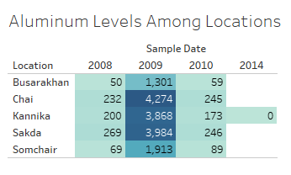
Toxicity of Chemicals
Aluminum - High levels of aluminum can be hazardous and toxic. It was found in high concentrations in 2009. Boonsri and Chai are among the highest producers for that year.
Aluminum is released into the environment from natural processes, industrial processes using aluminum, and incinerators.
Aluminum in high quantities can inhibit an aquatic organism's ability to regulate salt concentrations and clog fish gills, potentially resulting in death or affecting growth and reproduction.
Notes:
Hasn’t shown up in 5/6 years, so we can presume that it will not causes major environmental issues

Slide 9
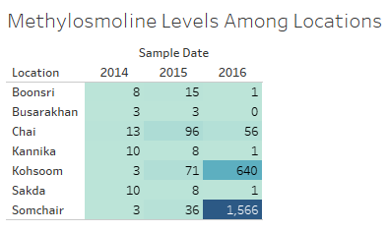
Toxicity of Chemicals
Methylosmoline - Methylosmoline is certainly toxic at nearly any concentration. It was found in multiple locations across multiple years. This is a cause for concern and was the chemical of the suspected dumping.
Notes:
Big jump from 2015 to 2016 at Kohsoom and Somchair

Slide 10
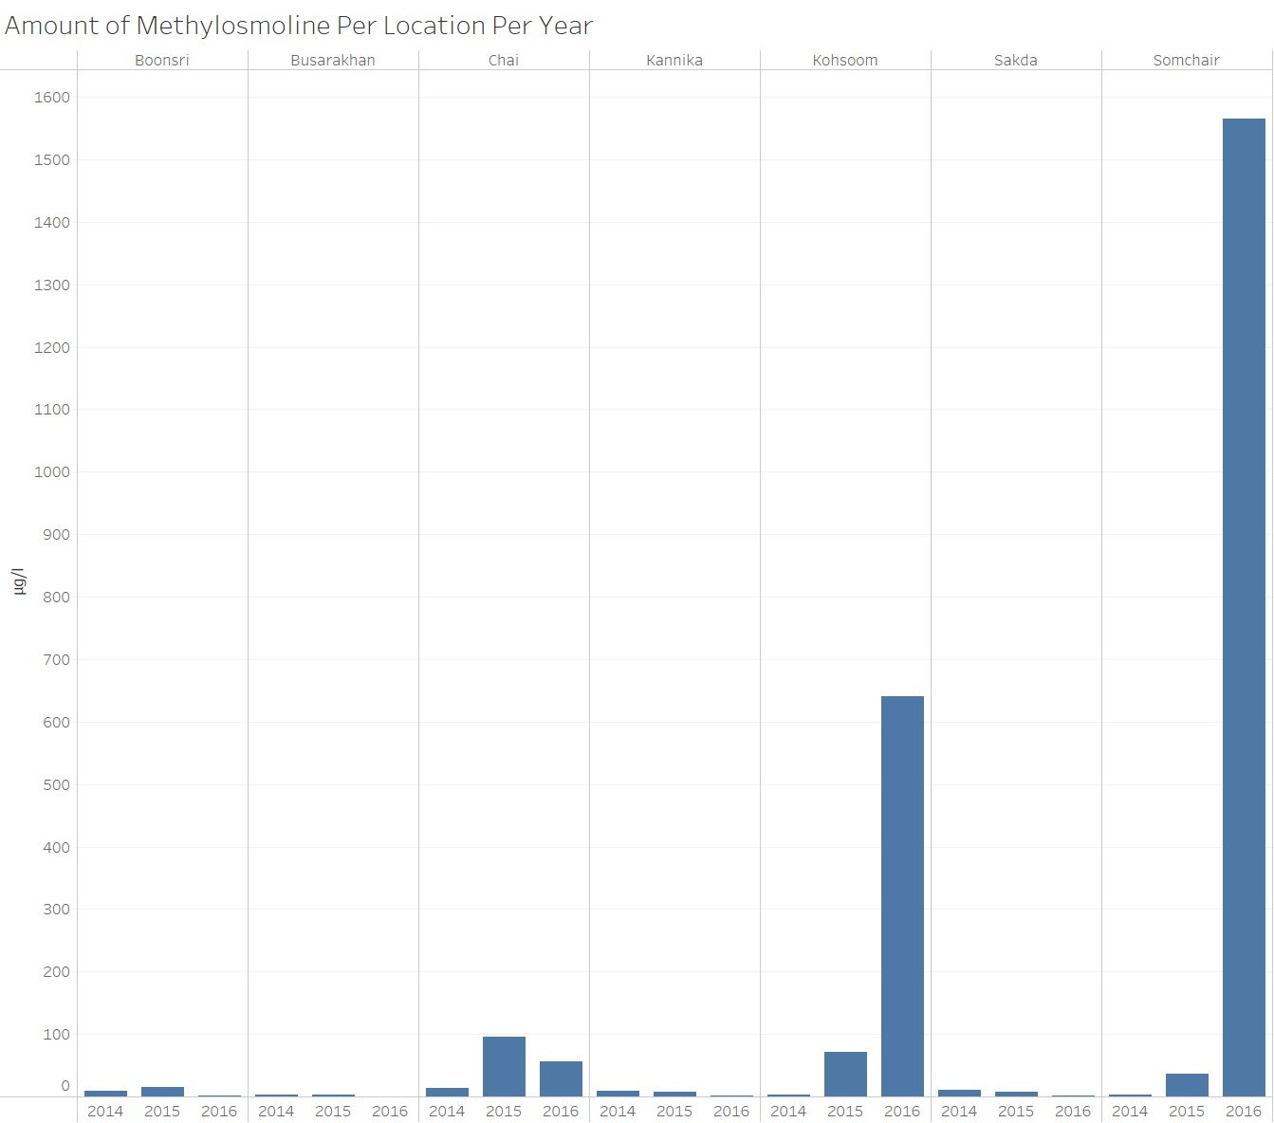
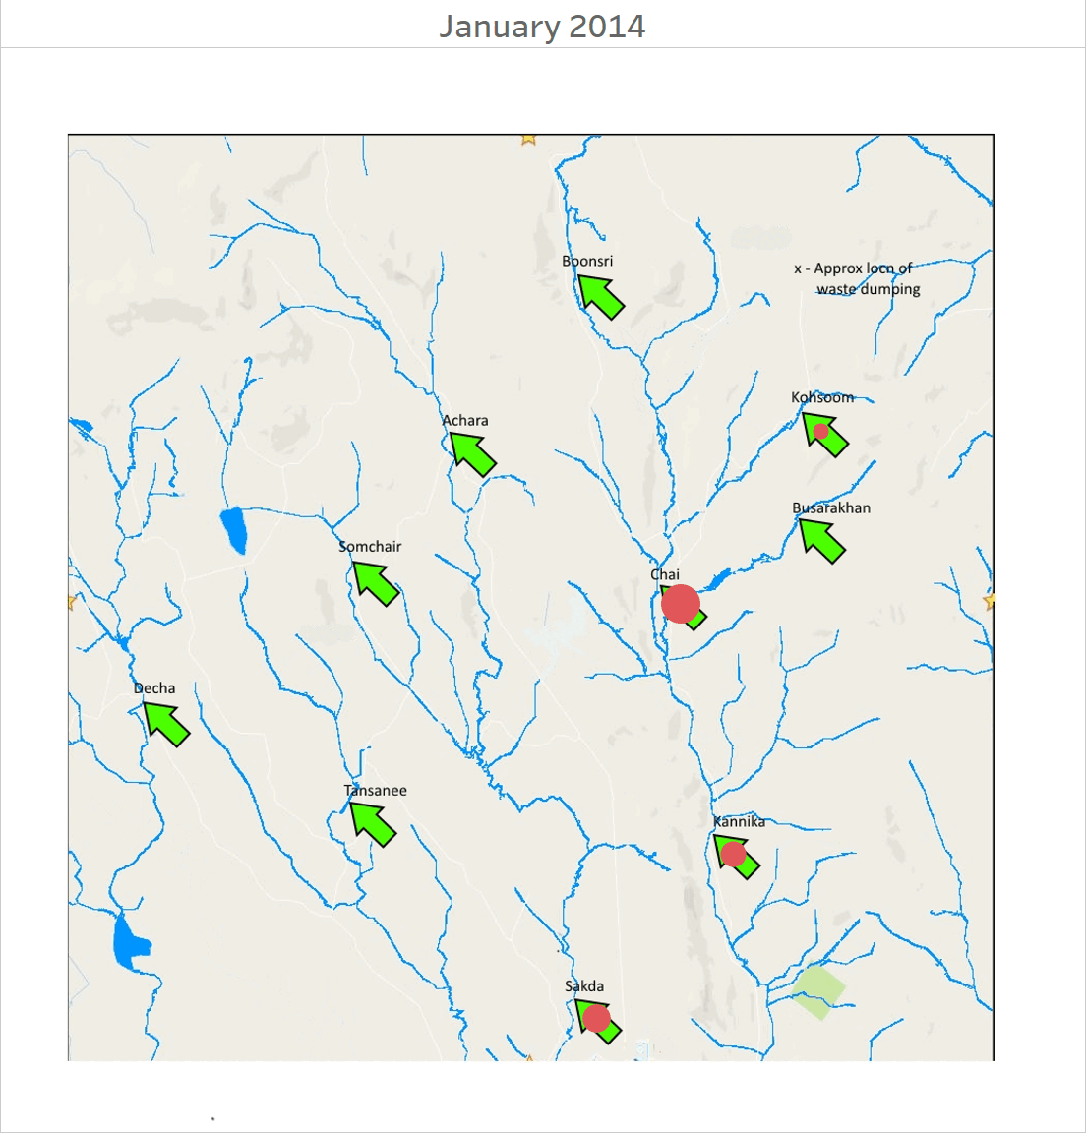
Methylosmoline Per Year
Methylosmoline Per Month
Notes:
Chart on the left shows the amount measured in each location per year
Chart on the right goes through every month from 2014 to 2016 showing how the amount measured at each location changes over time. Larger the circle the more that was measured there.
If the amount continues to rise as it is then there will be concerns for the wildlife in the area

Slide 11
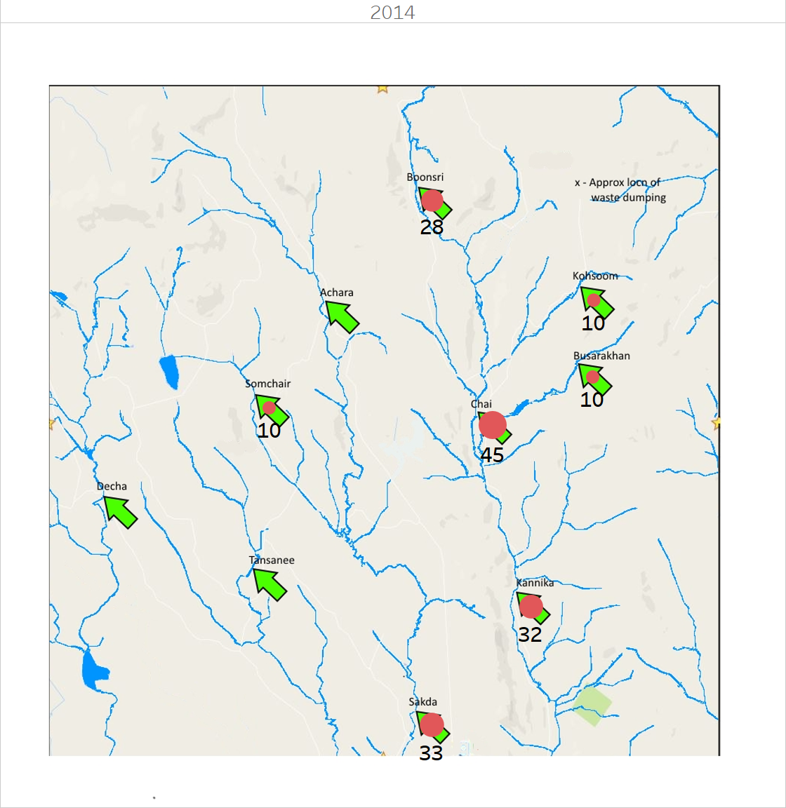
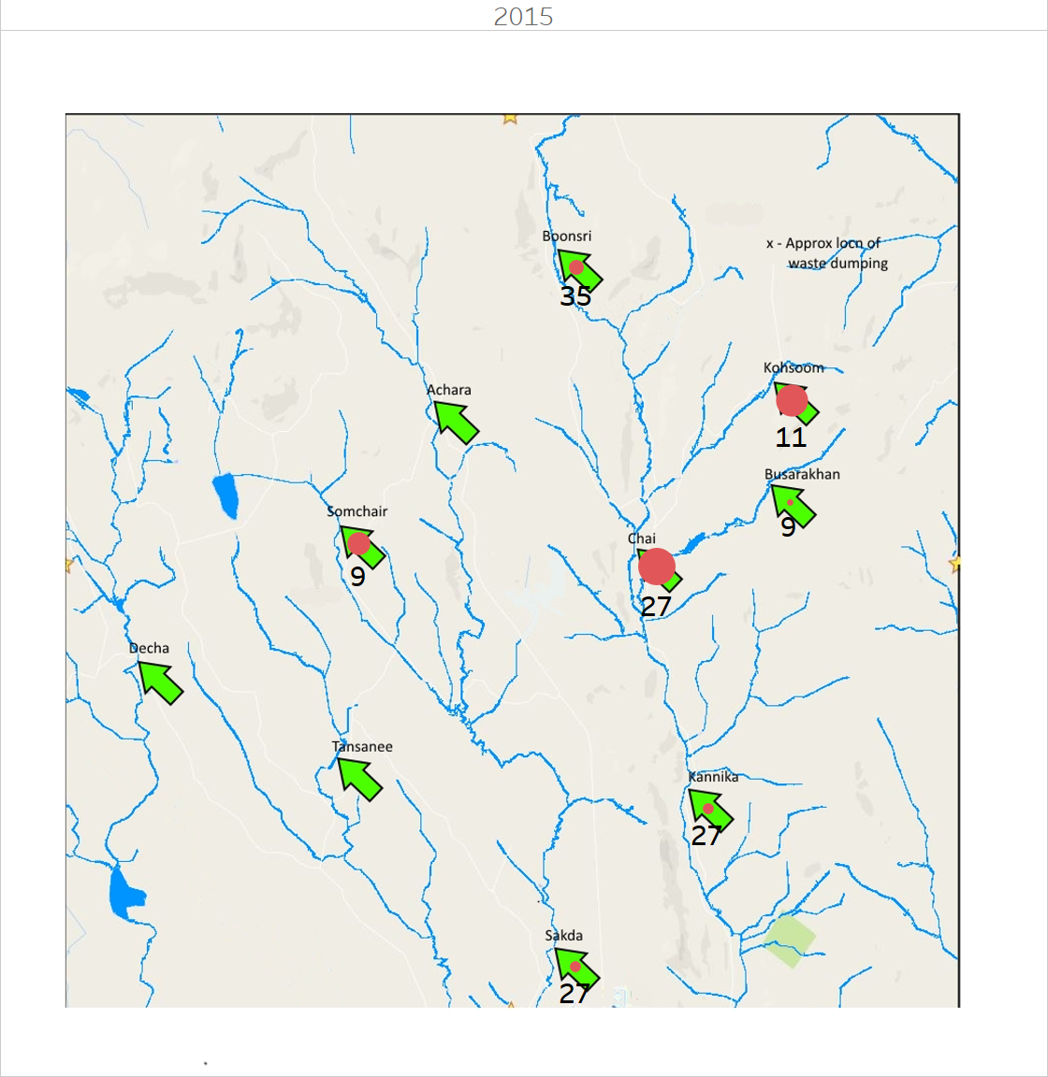
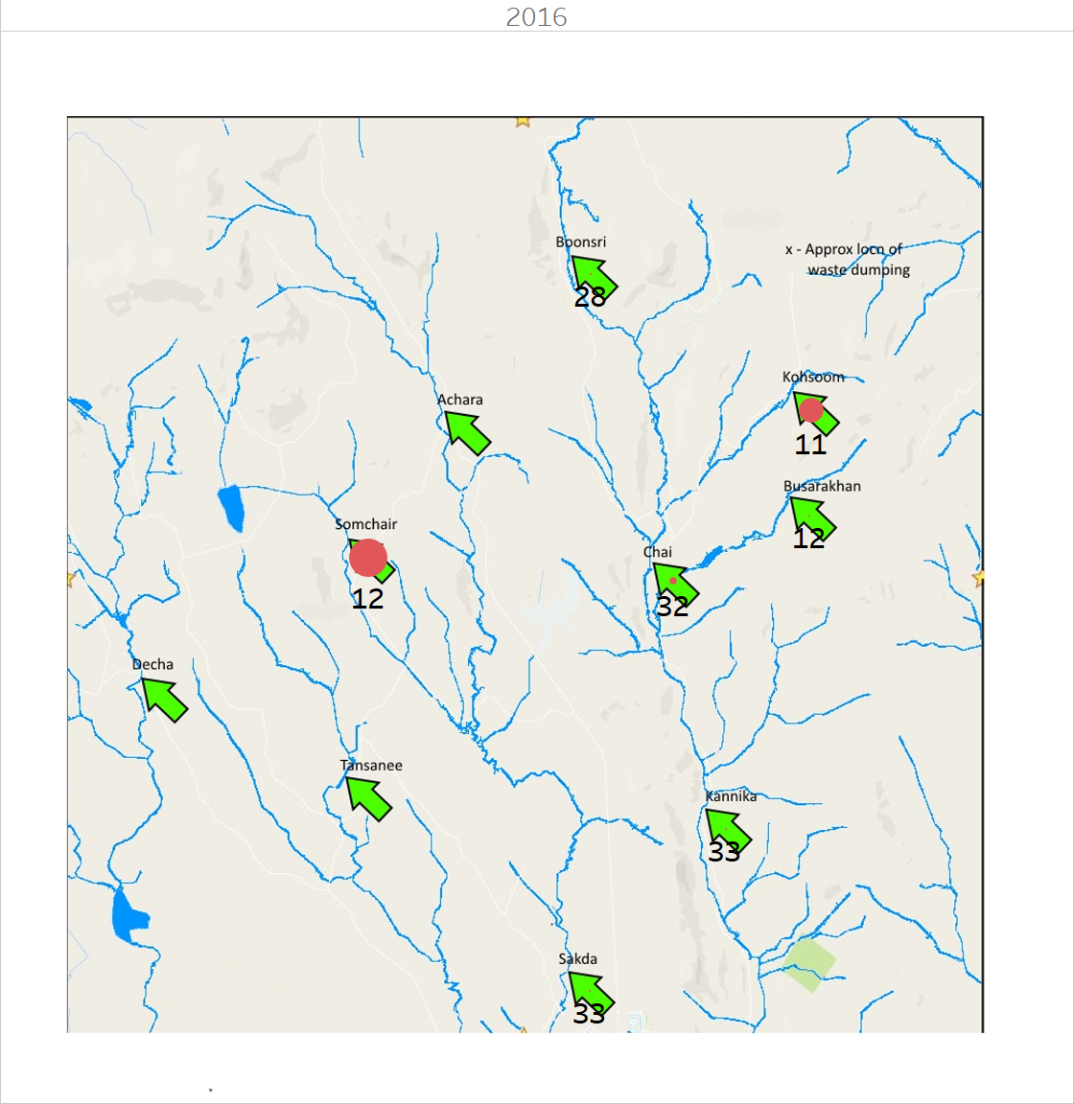
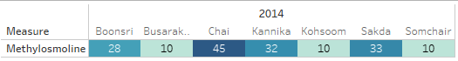
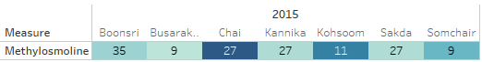
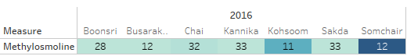
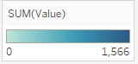
Methylosmoline
# of Times Measured Vs Measured Amount
Notes:
Bigger the circle the more that was measured there. The number below the circle is the amount of times it was measured at that location.
Chart below shows the same data just using numbers. Darker the color the larger the amount of Methylosoline was measured. The number is the # of times it was measured
2016 in Somchair it was only measured 12 times but yet it has the largest amount.
For 2014 & 2015 the place with the most # of measurements is the one with the highest measure of Methylosoline.

Slide 12
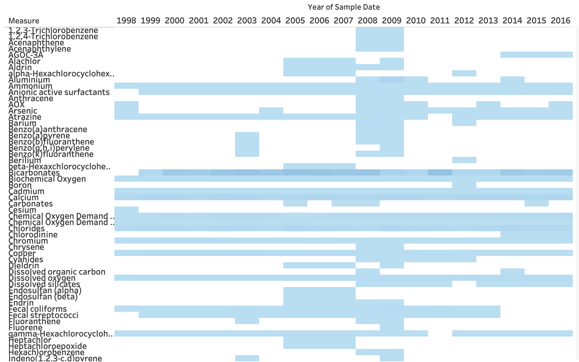
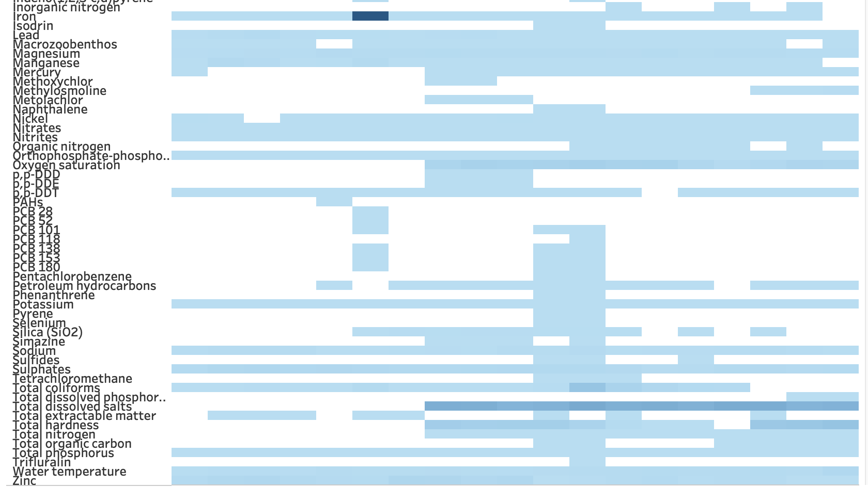
Sampling and
Collection Issues
Notes:
Heat map shows the collection chemical data through the years. Lighter blue, lower measurements. Darker blue, higher measurements. White spots show no measurements during those years. Inconsistent collection of chemical data.

Slide 13
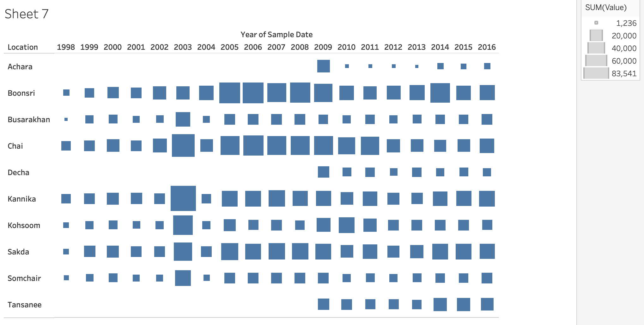
Sampling and Collection Issues
Notes:
Heat map of location vs year. Three locations (Achara, Decha, Tansanee) didn’t have any data collected until 2009.

Slide 14
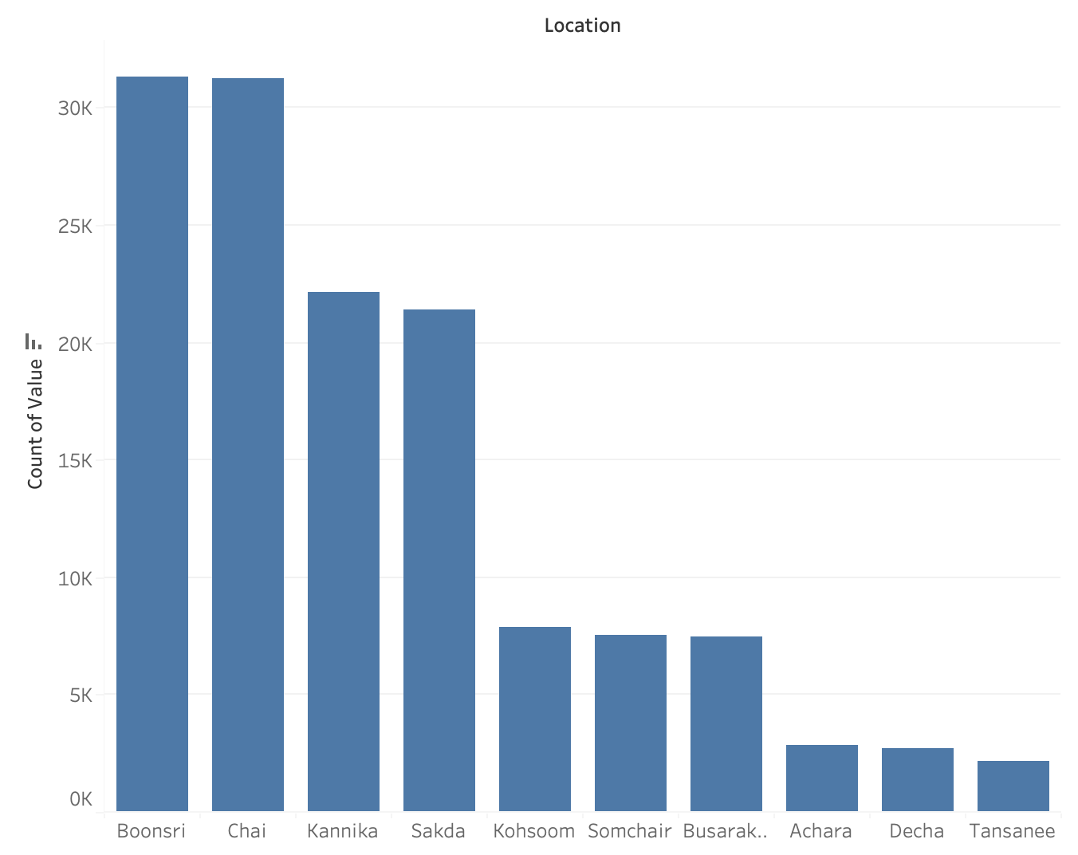
Sampling and
Collection Issues
Notes:
Bar graph shows the number of measurements at each location. The number of measurements is not uniformly distributed amongst the locations. The locations Boonsri and Chai have many more measurements than the other locations. Could impact findings.

Slide 15
Thank you!

